Slide 1
Final project: analysis of obstetric violence experienced by women based on the ENDIREH 2021 survey
Daniel Sañudo Rivera
Cristina González Zorrilla
Mónica Alvarez Estrada
Data Analytics Bootcamp 2022
Tecnológico de Monterrey

Slide 2
Violence against women is one of the extreme forms in which inequality is manifested against the essential rights of women. To address this problem, its quantification is indispensable, and so is the existence of reliable and comparable statistics and indicators.
Therefore, in Mexico, statistical projects have been conducted to get a better understanding of the phenomenon of violence against women, its characteristics and magnitude.
For the final project we decided to address gender violence, specifically obstetric violence, i.e. any type of violence, both verbal and physical, that women experience during pregnancy.

Slide 3


National Survey on the Dynamics of Household Relationships

Slide 4
ENDIREH offers information of the situation of violence experienced by women in Mexico.
It has public information on the experiences of physical, economic, sexual, emotional and patrimonial violence that women 15 years and older faced in the different areas of their lives (intimate partner, family, school, work and community)

Slide 5
Description of the data:
Conducted every 5 years
Representative at the national and federative levels
Sample size: 140,784 dwellings
Sampling scheme: probabilistic, three-stage, stratified and clustered
Period: october 4 to november 30, 2021

Slide 6
Obstetric violence
Since 2016 edition, the ENDIREH has added 12 questions to refer to obstetric care. These questions are addressed to women 15 years and older, single or married, who have given birth in the last 5 years.

Slide 7
Questions:
What variables influence women to suffer obstetric violence?
Women with partners are more likely to experience aggression from medical personnel?
Is the region they live related to being exposed to obstetric violence?
Is the socioeconomic level related to women who suffer obstetric violence?

Slide 8
Data exploration phase:
After deciding the topic “Obstetric Violence”, we chose the databases that contain relevant information about it to start working on our project.
We make sure the csv’s contained important information about our chosen topic.
We reviewed the formatting of the survey responses making sure they were useful for our investigation.

Slide 9
Tables
TVIV: contains the basic characteristics of the dwellings (services and goods available) as well as the number of persons usually residing there.
TSDem: contains the socio-demographic, economic and cultural characteristics of each of the persons residing in the dwelling.
TB_SEC_III: contains the information that identifies the women who are 15 years old and older who reside in the dwelling, and verifies the marital status of the respondent.

Slide 10
Tables
TB_SEC_IV: contains basic information about the partner, husband, boyfriend or ex-partner of women who do not reside in the selected woman's household. It also provides information on the earned income of the woman and her partner, as well as other sources of income available to the woman. It delves into the assets and property owned by the persons residing in the dwelling, specifically the woman selected for the survey.
TB_SEC_X: contains information on obstetric care received by women aged 15-49 who had a pregnancy during the last five years.

Slide 11
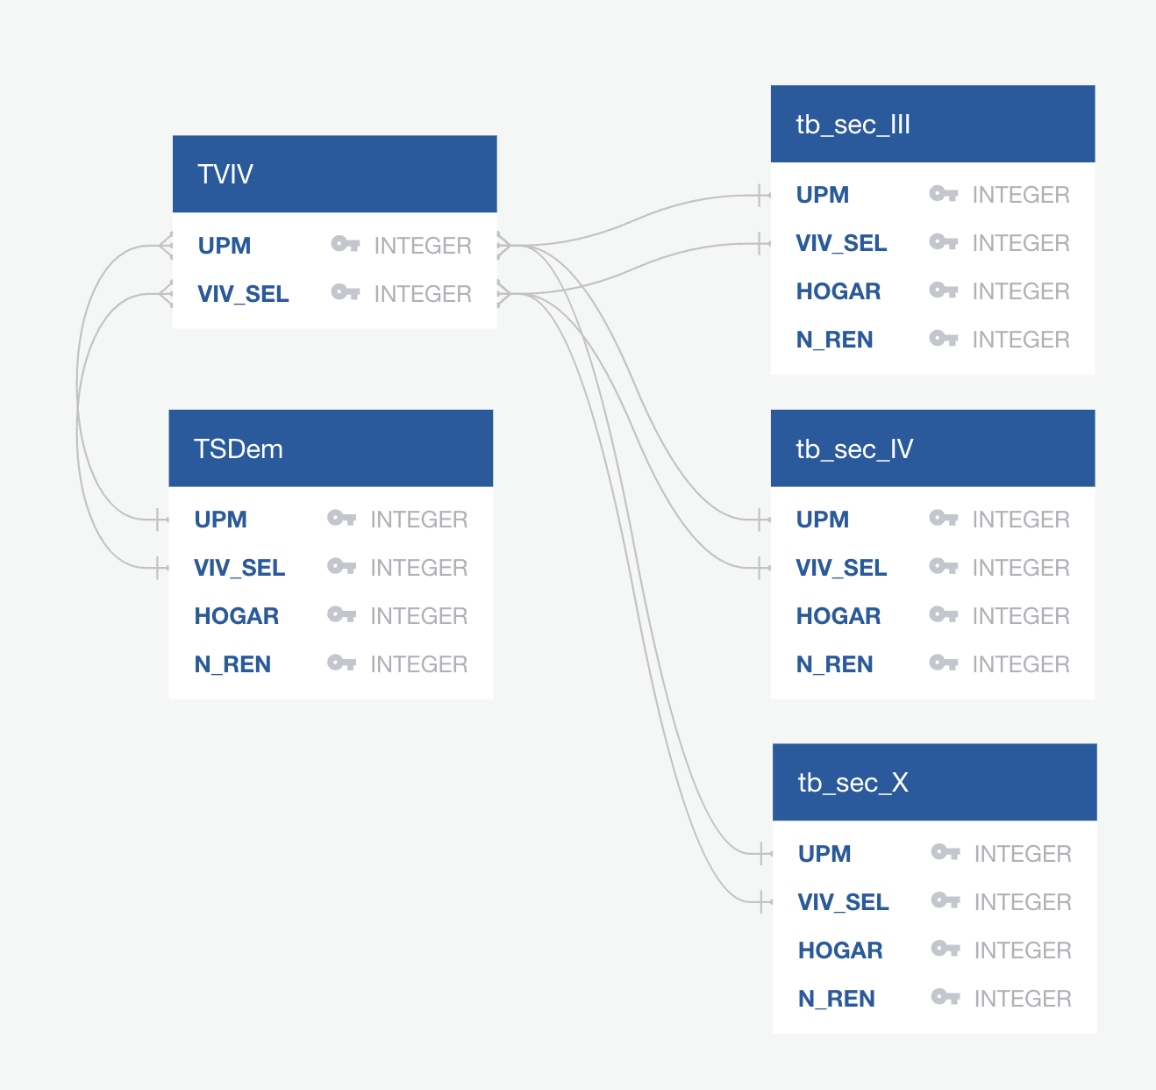
ERD

Slide 12
Data analysis phase:
We used ERD to discover the primary keys of each csv.
We used SQL to join the 5 csv´s.
We upload the csv to AWS.
Using Random forest, we cleaned the data, erasing the columns that were not necessary for our database such as:
- 'ID_VIV', 'ID_PER' ,'UPM', 'VIV_SEL', 'HOGAR', 'N_REN' we discarded because their use if as an identifier of the person surveyed.
- 'CVE_ENT', 'CVE_MUN', we discarded them because we opted to preserve the name of the state and having the CVE of municipalities and states will be unnecessary.
- NOM_MUN was discarded since we decided to work only with the states of the country instead of municipality

Slide 13
Data analysis phase:
COD_RES we discarded because the only value registered in this column is 1.
EST_DIS y UPM_DIS they were discarded because they are variables related to the sampling technique used.
ESTRATO it was discarded because there is no clear information about what it means.
NOMBRE it was discarded for two reasons, the name of the person is not relevant to the model and the names of the people surveyed were not recorded.
SEXO it was discarded because we only had 1 value as an answer.
COD_M15 it was discarded because people surveyed are used as identifiers

Slide 14
Data analysis phase:
CODIGO it was discarded because people surveyed are used as identifiers
REN_INF_AD y N_REN_ESP were discarded becase as well as N_REN y REN_MUJ, are used to reference other value of the table.
T_INSTRUM was descarded because it have the same information of the P3_8.
FAC_VIV y FAC_MUJ discarded because they are calculated with the questions that are already being analyzed in the model.
PAREN was discarded because it is used to review the relationship of the respondent with the head of the household.
GRA was discarded because the NIV column have relevant information about the education level of the person.

Slide 15
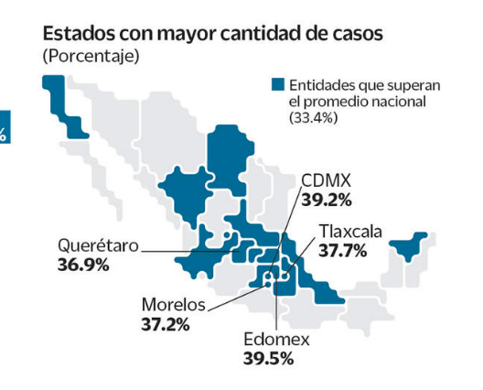
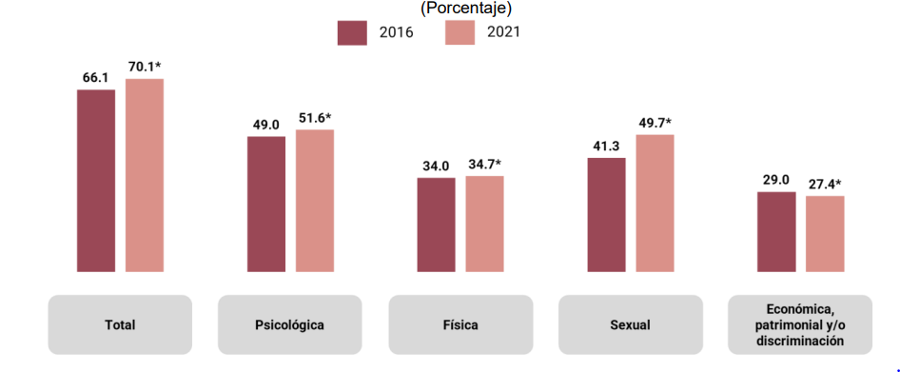
Dashboards
We will create the dashboards in tableau.

Slide 16
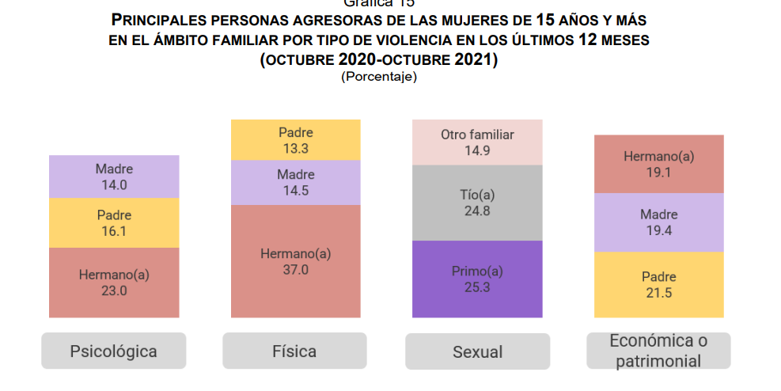
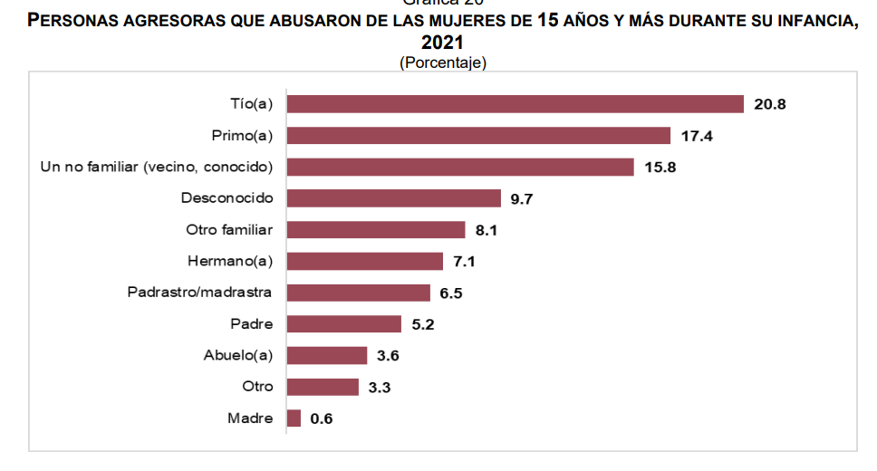
Dashboards
We want to create interactive graphics were you will be able to choose the state, age, economical status and status relationship of women and you will get the actual information of the obstetric violence. Everything will be done through tableau.

Slide 17
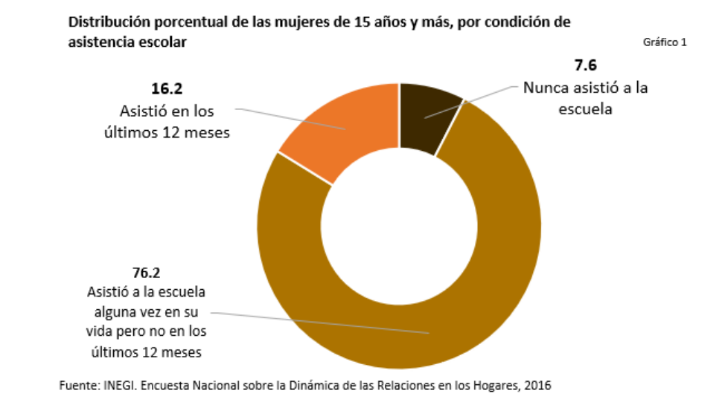
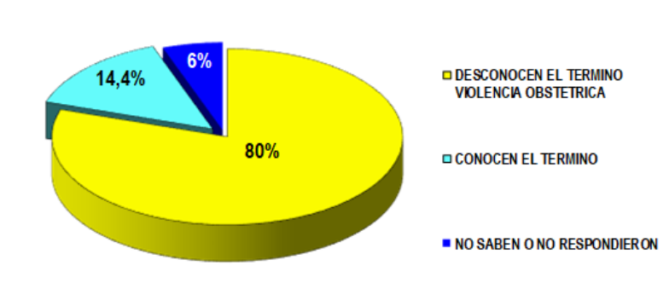
Dashboards
These are some examples of the dashboards we will create in our investigation.

Slide 18
Storyboard
1. Brief intro about Obstetric Violence.
2. Data exploration Phase
3. Tools used in the project.
4. Questions about our investigation.
5. Percentage of Obstetric violence responses.
6. Table of obstetric violence by federal entity.
7. Graph of obstetric violence by Federal Entity.
8. Tables with Obstetric Violence according socioeconomic level
9. Tables with Obstetric Violence with women’s relationship status.
10. Graph obstetric violence according to escolarity
10. Conclusion

